Slide 1
Optimizing your algorithms
Computer architecture
dsp./isp
Computer vision

Slide 2
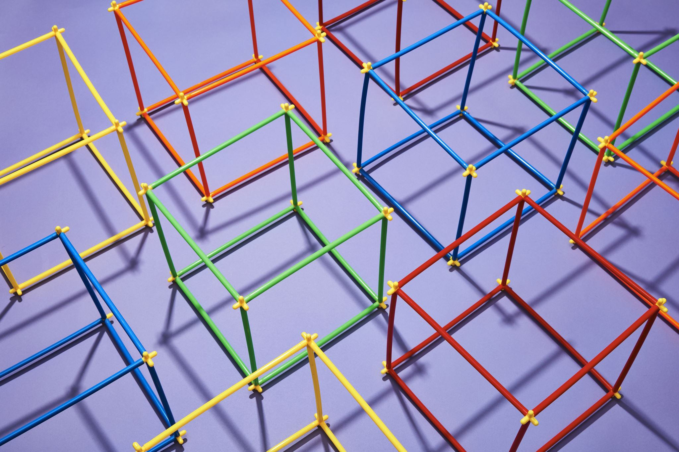
Optimizing your algorithms
Why do we even need to optimize algorithms?
What are the different aspects we should be looking at
Who benefits from it?
We talk Non-GPU approaches

Slide 3
Why do we need optimization
Implementing optimization algorithms involves understanding both the problem and the algorithm, choosing the right programming language, and appreciating the complexities and limitations
Improve cpu usage
Improve memory usage
Improve overall system performance

Slide 4
BASIC OPTIMIZATIONS
Some examples of algorithmic improvements
Precompute repetitive values
Sine, cosine, sqrt tables.
Loop unwrapping
Sampling/subsampling – MaxPool?
Threading
Vectorize (hardware must support it)
Choice of Language
Python or C or Java?
Hardware aspects to be considered
Touch bare metal
Multi-threaded
Python GIL, async
C/C++, TBB, MPI, Standard Threading

Slide 5
COMPLEXITIES
Costant O(1)
Linear O(n)
Quadratic O(n^2)
Decaying O(log n)
Array access via index
Single loop access to check a value
Double loop
Binary sort

Slide 6
Computer architecture
MMX, SSE, SSE2
MMX (Multimedia Extensions) introduced in 1997, added 64-bit SIMD instructions to x86Allowed parallel processing of 8 8-bit, 4 16-bit or 2 32-bit integers
Accelerated multimedia workloads like video codecs, image processing. SSE (Streaming SIMD Extensions) introduced in 1999, added 128-bit registers and floating point SIMD. Enables parallel processing of 4 32-bit floats or 2 64-bit doubles
Crucial for accelerating computer vision algorithms like feature detection, image filtering
SSE2 introduced in 2001, expanded SIMD to integer operations on 128-bit registers. Allows parallel processing of 16 8-bit, 8 16-bit or 4 32-bit integers Useful for accelerating fixed-point computer vision algorithms
AVX, AVX2
AVX (Advanced Vector Extensions) introduced in 2011, expanded SIMD to 256-bit registers Enabled parallel processing of 8 32-bit floats or 4 64-bit doubles
Significant performance boost for floating point intensive computer vision algorithms
AVX2 introduced in 2013, added integer SIMD operations on 256-bit registers. Parallel processing of 32 8-bit, 16 16-bit or 8 32-bit integers
Useful for accelerating both fixed-point and floating point computer vision workloads

Slide 7
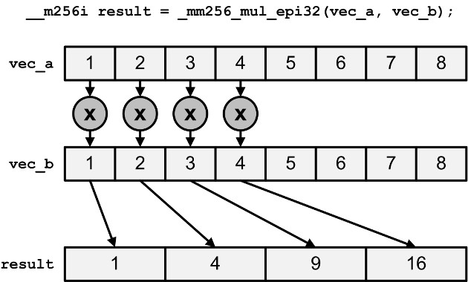
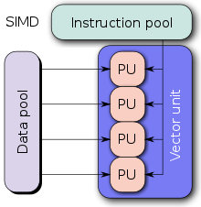
https://www.codeproject.com/Articles/874396/Crunching-Numbers-with-AVX-and-AVX2

Slide 8
Does pytorch support avx ?
Yes it does
print(torch.__config__.show())
CPU Capabilities: AVX2 and PERF_WITH_AVX=1, PERF_WITH_AVX2=1, PERF_WITH_AVX512=1 in the build settings
AVX2 support in PyTorch

Slide 9

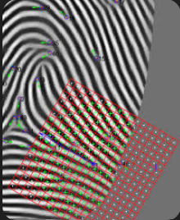
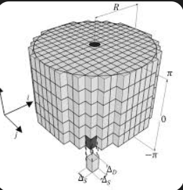
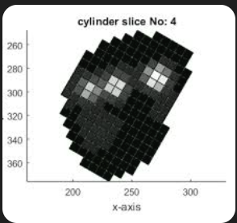
Accelerating fingerprint matching – production example
MINUTIAE MATCHING – 3D TO 1D
FEATURE COMPRESSION
FLOATING POINT TO INTEGER BASED
AVX2
BINARY FEATURE MATCHING
POPCOUNT – FASTER ON LINUX, SLOWER ON WINDOWS
500 MATCHES/SECOND TO 500K MATCHES PER SECOND
PARALLEL, INTEL HASWELL PROCESSOR.
MIX OF C/C++ AND OPENCV

Slide 10
FASTER OPERATIONS
ADDITION, SUBTRACTION, MULTIPLICATION, DIVISION OF FLOATING POINTS

Slide 11
ARITHMETIC UNITS
INTEGERS
FLOATS
DEDICATED HARDWARE
NO FLOATING POINT VALUES
NO NEED TO HANDLE DECIMAL
NO EXTRA CPU OPS
Short, integer
FLOATING POINT VALUES
NEEDS TO HANDLE DECIMAL POINT
MORE CPU OPS
Float, long, double
AVX/AVX2 DEDICATED FLOATING POINT PROCESSING UNITS
NVIDIA GPUS – DEDICATED FLOATING POINT PROCESSING UNITS
CISC, RISC, RISC-V

Slide 12
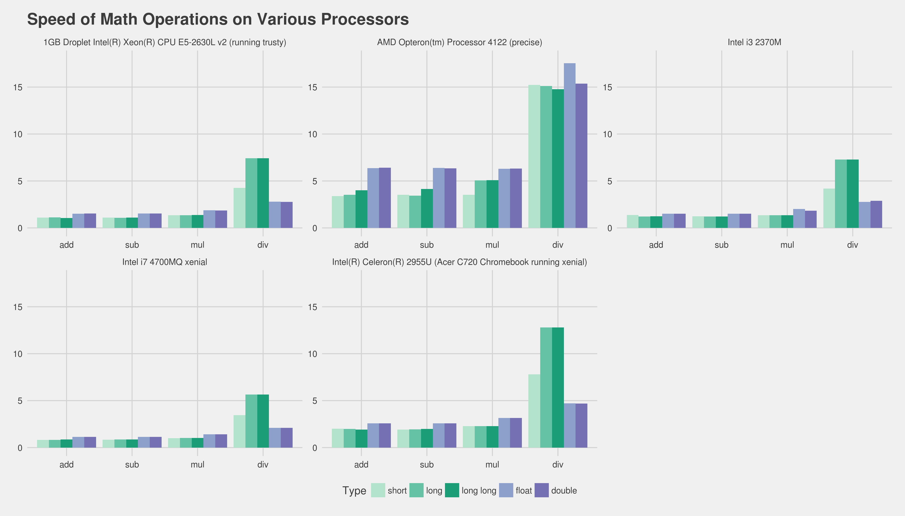
https://i.sstatic.net/rbPmq.png

Slide 13
DSP/ISP – importance of algorithms & h/w
VIDEO ENCODING / DECODING
H.264, A compression/decompression codec
Raw video can be terabytes and not good for live or real-time streaming
Video data is massive, need to process gigabytes per second for HD/4K video Computationally intensive algorithms like motion estimation, DCT, quantization
Strict real-time constraints, frames must be processed in 16-40ms
Efficient algorithms and hardware acceleration are critical for real-time performance. Software codecs alone cannot keep up with high resolution video
Hardware accelerators like MMS, SSE, AVX etc can be leveraged to speed up the process

Slide 14
DSP/ISP – importance of algorithms & h/w
Leveraging SIMD extensions
SIMD instructions can be used to parallelize key video codec algorithms
Motion estimation: Perform sum of absolute differences (SAD) in parallel
DCT/IDCT: Compute 1D DCT/IDCT on multiple pixels simultaneously
Quantization: Quantize multiple coefficients in parallel
Significant speedups possible by exploiting SIMD, e.g. 2-4x with SSE, 4-8x with AVX
Example: x264 video encoder uses SSE/AVX extensively for real-time performance

Slide 15
DSP/ISP – importance of algorithms & h/w
Designing video codecs to match capabilities of target hardware is crucial.
Exploit SIMD, caches, memory bandwidth, execution units, etc.
Avoid bottlenecks, e.g. memory bandwidth, branch mispredictions
Example: Aligning data structures to cache lines to avoid false sharing.
Careful memory access patterns to maximize cache hits

Slide 16
Computer vision
Stereo Matching - parallel
Image Stitching – parallel
HoG features – parallel
LBP – parallel

Slide 17
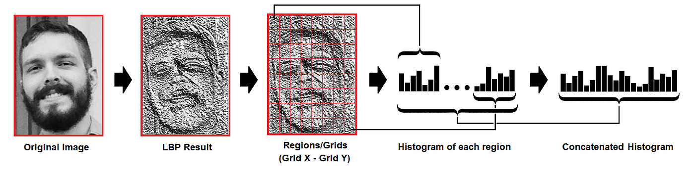
Local binary pattern
https://miro.medium.com/v2/resize:fit:1400/1*-cyqWPcas3CXp4O2O7xPpg.png

Slide 18
QUANTIZATION
INFORMATION RETRIEVAL
FLOATING POINT TO INTEGER – NOW USED IN RAG SYSTEMS
QUANTIZED KD-TREE WITH 8 MILLION VIDEO FRAMES
UNDER 2 SECOND INFORMATION RETRIEVAL
INTEGER OPS MEAN FASTER OPERATIONS
LOSS OF ACCURACY AND SPEED TRADE-OFF

Slide 19
Some libraries to consider
FFMPEG - Compile and Build for AVX2 or GPU
Intel Extensions for Scikit-Learn
OpenCV – Compile and Build for AVX,TBB or GPU
Intel Math Kernel Library (MKL) / DNN
Linear Algebra Pack (LAPACK)
NNPACK

Slide 20
Thank You
No Devin shall replace a C/C++ developer!

